Slide 1



Customer Churn prediction
Done by:
Sravya Degala
Sarath Chandra

Slide 2


Scope of the Problem:
Customer churn is a major problem and one of the most important concerns for large companies.
Due to the direct effect on the revenues of the companies, especially in the telecom field, companies are seeking to develop means to predict potential customer to churn.
Therefore, finding factors that increase customer churn is important to take necessary actions to reduce this churn.
The main contribution of our work is to develop a churn prediction model which assists telecom operators to predict customers who are most likely subject to churn.

Slide 3






Insights Of EDA
Service Usage:
Understanding the services each customer has signed up for and there are people with no services and that can provide insights into their preferences and needs.
Customer Account Information:
Examining customer account information, such as
Contract Type
Payment Method
Billing Preference
Total Charges

Slide 4
Insights Of EDA
Service Usage:
Understanding the services each customer has signed up for and there are people with no services and that can provide insights into their preferences and needs.
Customer Account Information:
Examining customer account information, such as
Contract Type
Payment Method
Billing Preference

Slide 5
Insights Of EDA
Service Usage:
Understanding the services each customer has signed up for and there are people with no services and that can provide insights into their preferences and needs.
Customer Account Information:
Examining customer account information, such as
Payment Method

Slide 6
Insights Of EDA
Service Usage:
Understanding the services each customer has signed up for and there are people with no services and that can provide insights into their preferences and needs.
Customer Account Information:
Examining customer account information, such as
Billing Preference

Slide 7
Insights Of EDA
Service Usage:
Understanding the services each customer has signed up for and there are people with no services and that can provide insights into their preferences and needs.
Customer Account Information:
Examining customer account information, such as
Total Charges

Slide 8
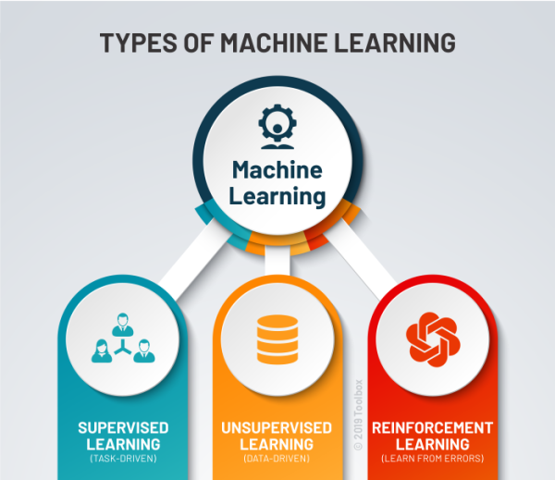
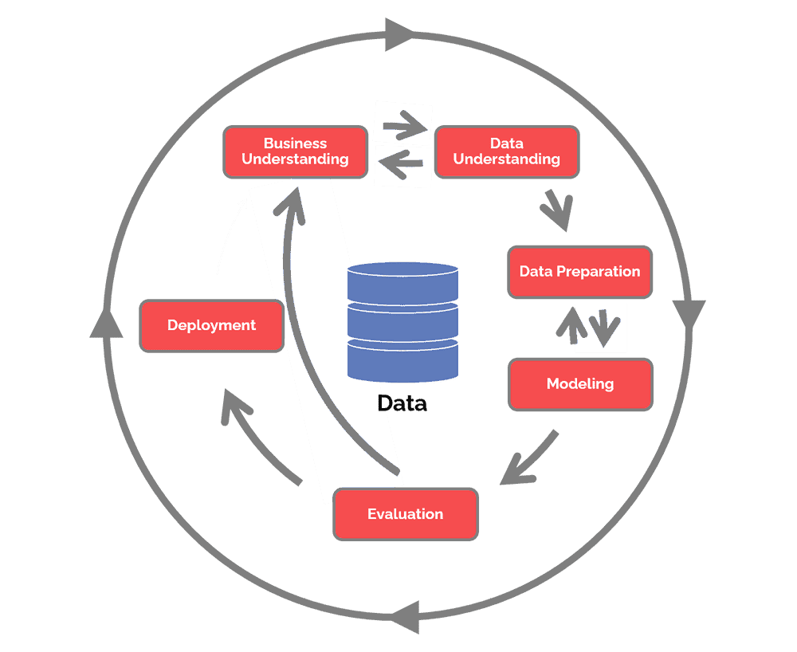
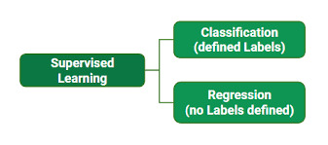
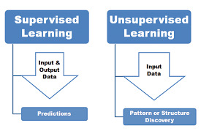
Types of Machine learning:
Classification
Regression

Slide 9
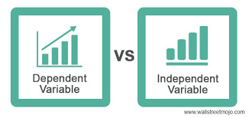
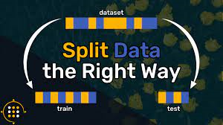
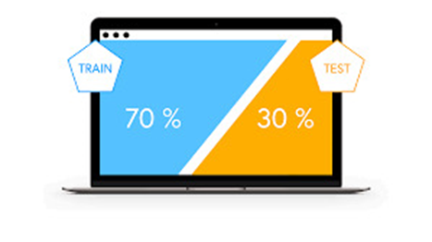
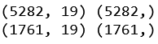
Identification of Input and Output Variables:
The input variables are
InternetService, OnlineSecurity, OnlineBackup, DeviceProtection, TechSupport, Contract, PaperlessBilling, PaymentMethod, MonthlyCharges, TotalCharges.
Splitting the data into Train and Test:
75 %
25 %

Slide 10

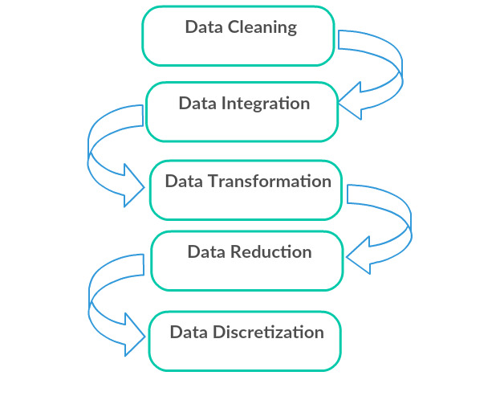
The phrase “Garbage-In , Garbage-Out” is particularly applicable in Data mining and machine learning projects.
Data in the real world is ‘dirty’:
Incomplete
Noisy
Inconsistent

Slide 11


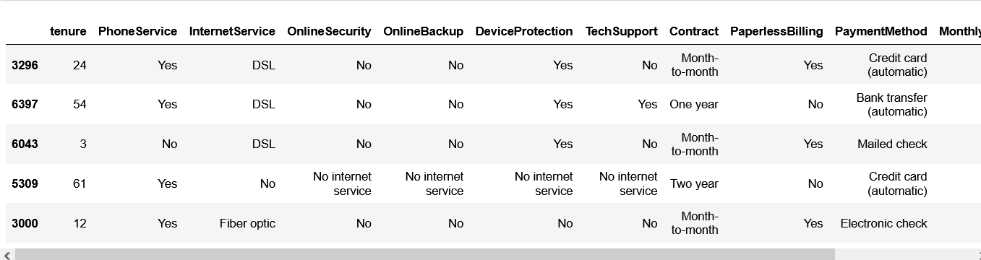
Data Preparation on Train Data:
Input
Data
Transformed
Input Data
Input Data
Categorical
Numerical

Slide 12
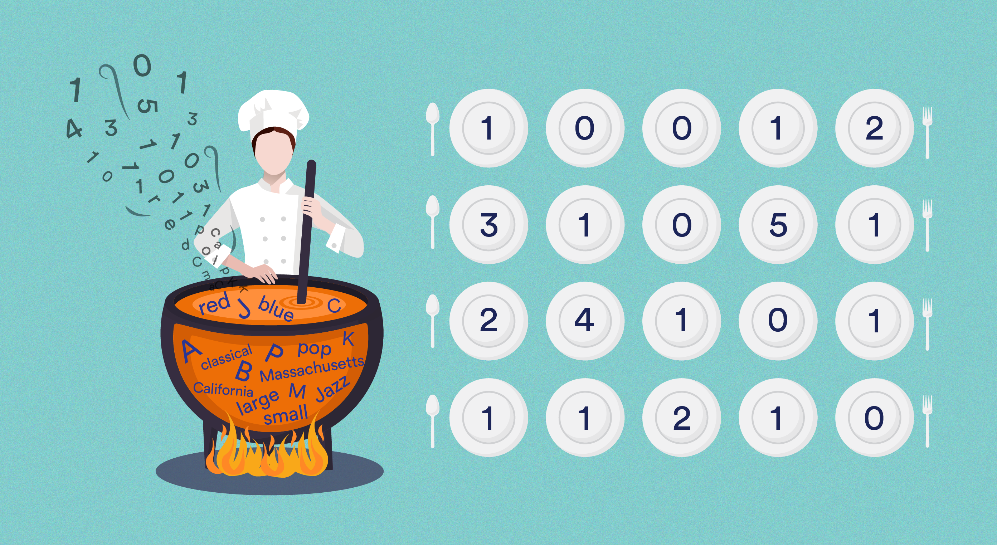
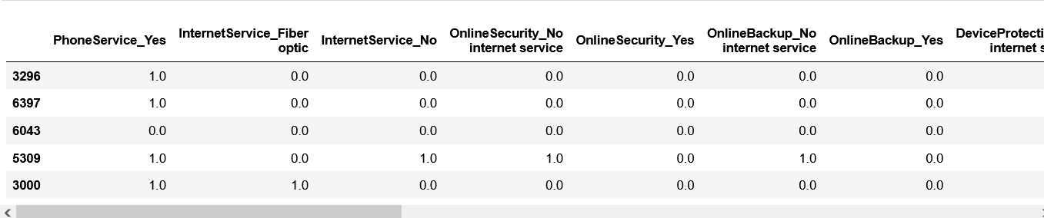
Transformed Train Data:
Transformed
Categorical data
Rescaled
Numerical data
Performed Fit and Transform on Training data.
Train data contains 75 % data of dataset.
Categorical (Nominal) : One-Hot encoding Categorical (Ordinal) : Label encoding
Numerical : Rescaling

Slide 13
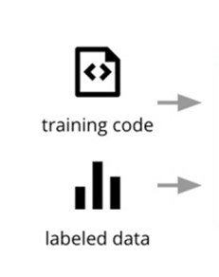

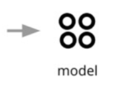
Model Building:
Model building involves the process of designing and constructing a predictive or analytical model using machine learning algorithms.
Selection of Algorithm depends on Target Variable.
Input data is trained with 5 different Algorithms namely
logistic regression, KNN, decision tree, Random Forest and Support vector classifier to build a model.
Discrete Feature : classification
Continuous Feature : Regression

Slide 14
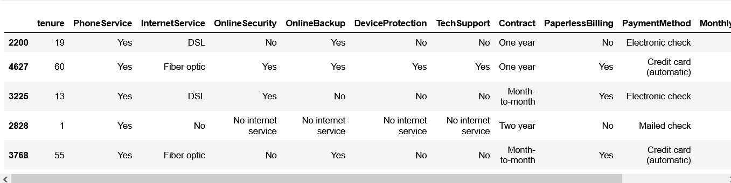

Data Preparation on Test Data:
Input
Data
Transformed
Input Data
Before Transformation
After Transformation

Slide 15
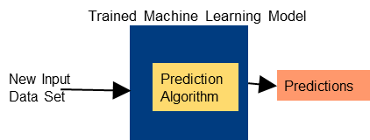
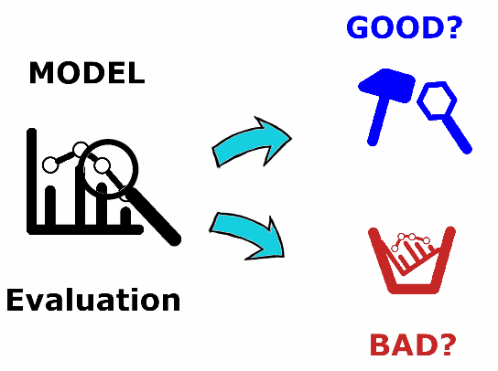
Prediction on Test data:
Predictions are forecasts about future events or outcomes based on available information.
Predictions often rely on data analysis techniques to identify patterns, relationships, and trends in historical data.
This information is then used to create models that can project future outcomes.
Evaluation:
Evaluation metrics are quantitative measures used to assess the performance or quality of a model, algorithm, or prediction.
Evaluation metrics vary depending on the specific field, task, and context involved.
There are different types of Evaluation Metrics:
Accuracy
Precision and Recall
F1 Score
Area Under the Curve (AUC)
Receiver Operating Characteristic (ROC) Curve
Confusion Matrix

Slide 16
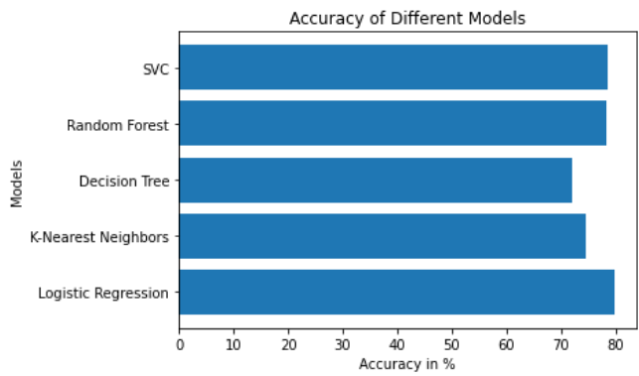
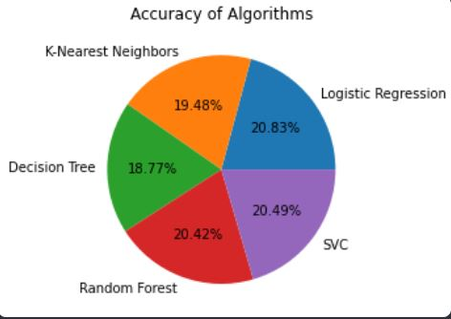
Comparison of Accuracies:
Conclusion:
Logistic Regression is the best model comparing to other ensemble methods.
It gives more accuracy than others.
Logistic Regression is the best model comparing to other ensemble methods.
It gives more accuracy than others.

Slide 17


